Slide 1

THE BEST NEIGHBORHOOD FOR YOUR NEW RESTAURANT
Where is the best place to open a new chinese restaurant in one of the most populated cities in the world?

Slide 2
Structure
Bussiness description
Introduction
Problem description
Data
Methodology section
Define de New York Dataset
Study of the neighborhood list with Chinese Restaurants
Evaluation of each Chinese restaurant
Discussion
Conclusions
Future directions

Slide 3

Bussiness description

Slide 4

Introduction
New York is one of the biggest and more international cities in the world.
The never sleep city is always a good choice to open a new restaurant.
Its fully of people open to try and taste new flavors.
Nevertheless, New York City is a big, great city with plenty of good restaurants, to be able to know the best place to open a new restaurant it’s need to study the market and the city.

Slide 5
Problem description
1- Study of the neighborhoods of New York by population and number of restaurants
2- Study of the boroughs by population and number of restaurants
3- Study of the available data of each Chinese restaurant

Slide 6

DATA

Slide 7

What data do we need?
- Borough and neighborhoods of New York City
- Population of each Borough and Neighborhood
- Chinesse restaurant in the New York City
- Chinesse restaurant per each Borough and neighborhood
- Valuation of each Chinese restaurant to make a ranking

Slide 8
DATA ACQUISITION AND CLEANING
New York Data available online
https://cocl.us/new_york_dataset
Coordinates of the different locations that we are going to use to search the best borough and neighborhood.
https://geocoder.readthedocs.io/index.html
Venues and venue-categories or near-venues for each neighborhood
https://foursquare.com
Creation a map displaying the most suitable areas for the new restaurant.
https://pypi.org/project/folium/

Slide 9

Methodology

Slide 10
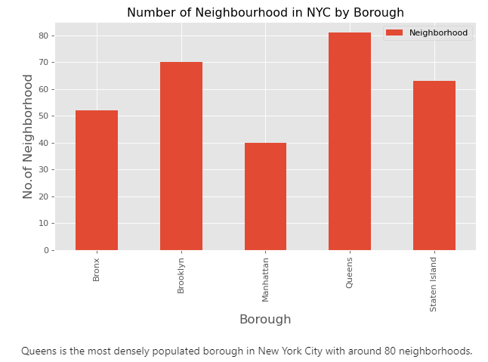
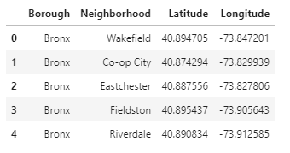
Define de New York Dataset
Queens is the most populated borough, with an approximate 80 neighborhoods.
Creation of the new york dataframe
display

Slide 11
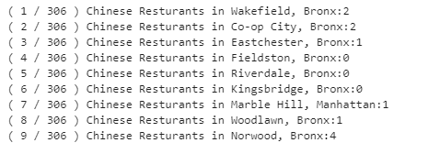
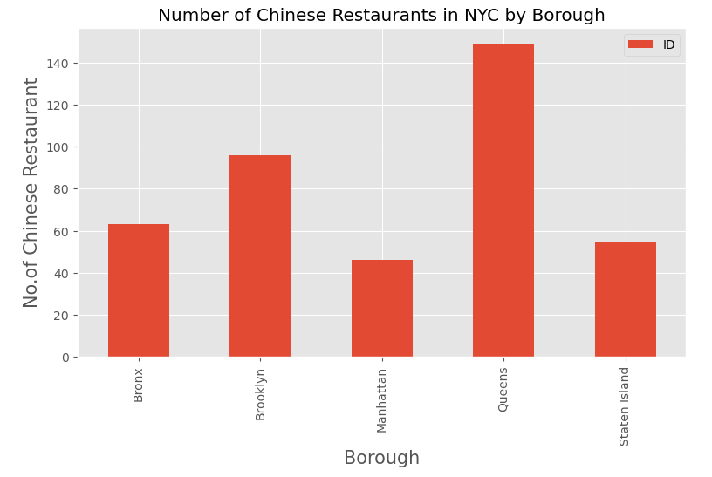
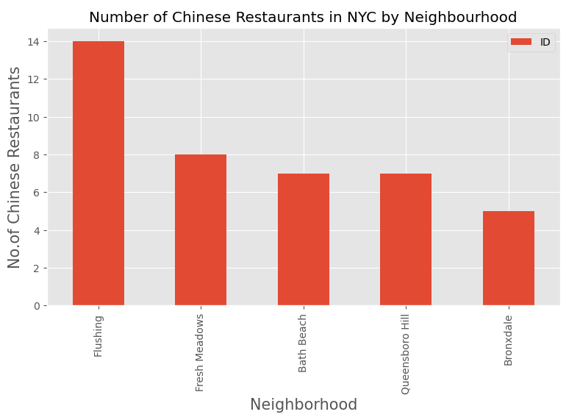
Study of the neighborhood list with Chinese Restaurants
Dataframe
Flushing is the Neighborhood with more number of Chinese Restaurants
Display
Queens is the Borough with more Chinese Restaurants.

Slide 12
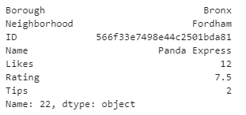

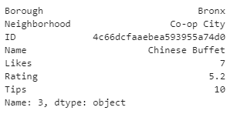
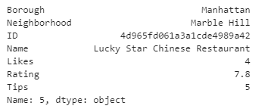
evaluation of each Chinese restaurant.
List of all the evaluation of the chinese restaurants
TOP ‘Likes’ restaurant
TOP ‘Tips’ restaurant
TOP ‘Rating’ restaurant

Slide 13
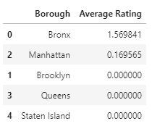
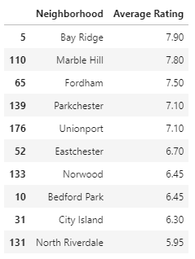
evaluation of each Chinese restaurant.
Borough sorted restaurants
Neighborhood sorted restaurants
The best restaurant in New York is in Bay Ridge neighborhood
The best rating restaurants in New York city is in Bronx

Slide 14
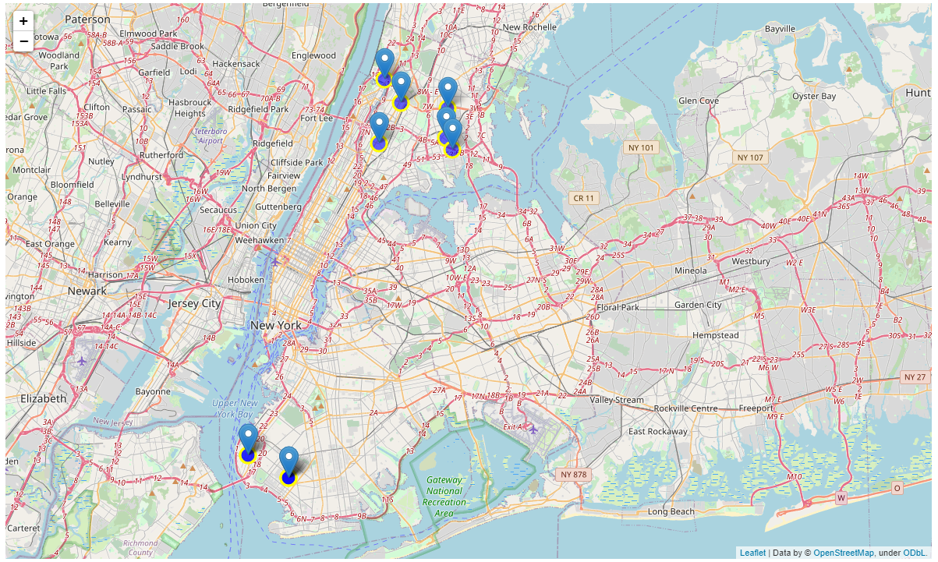
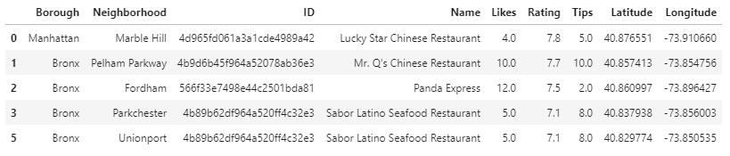
New york map with the best chinese restaurants locations

Slide 15

Results & conclusions

Slide 16

DISCUSSION
There are a lot of Chinese restaurant in New York city that are not value.
It's difficult to stablish an accurate study of where is the best place to open a new Chinese restaurant
Required a more intensively search of valuation from customers
The best ranking Chinese restaurant are in BROOKLYNG.
Nevertheless, is not possible to make a study of other borough due to the lack of information.

Slide 17

Conclusions
the most populated borough is Queens which also contains more of the chinese restaurants in New York.
This neighborhood is closed to brooklyng, which has the best rating chinese restauratns.
MAY A GOOD PLACE TO START A NEW RESTAURANT COULD BE BETWEEN BOTH BOROugh due to its close to the area with the best valuated chinese restaurants and closer to the big populated área of new york.
Esta foto de Autor desconocido está bajo licencia CC BY-SA-NC

Slide 18

Future directions
- Required more valuated restaurants
- Need of the owner?
Neighborhood
Quality
Type of customers

